Slide 1
Money Matters
Ecclesiastes 5:8–6:9
Dr. Rick Griffith • Crossroads International Church Singapore
CICFamily.com • BibleStudyDownloads.org

Slide 2
Can money buy happiness?
Notes:
Most people believe that more money leads to more happiness.
Many make fun of the old adage about money leading to happiness.

Slide 3
Title
Money can’t buy happiness
But it can buy a jet ski. Have you ever seen anyone sad on a jet ski?

Slide 4
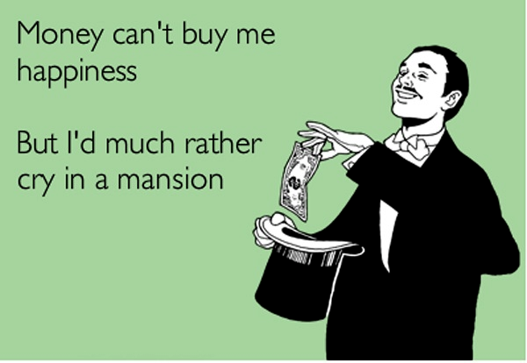
Title
Money can’t buy me happiness.
But I’d rather cry in a mansion.

Slide 5
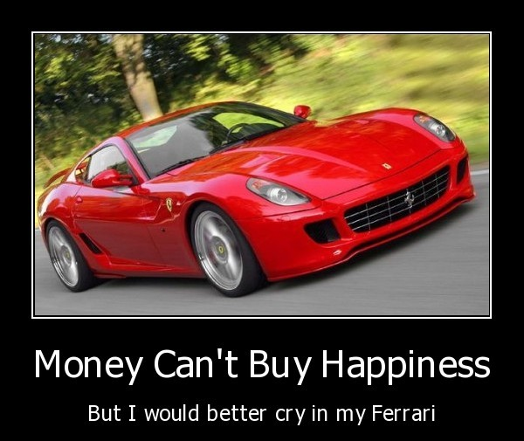
Title
Money Can’t Buy Happiness
But I would better cry in my Ferrari

Slide 6
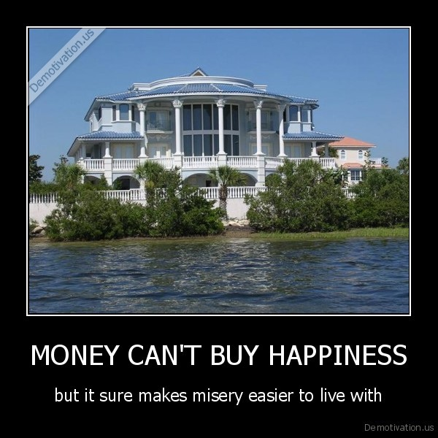
Title
Money Can’t Buy Happiness
But it sure makes misery easier to live with

Slide 7
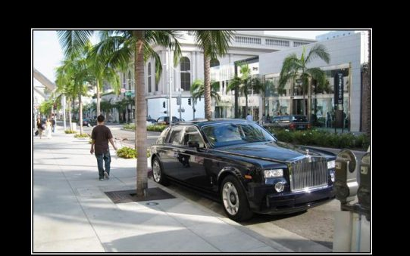
Title
Money Can’t Buy Happiness
But it let’s you shop for it in a better neighborhood

Slide 8
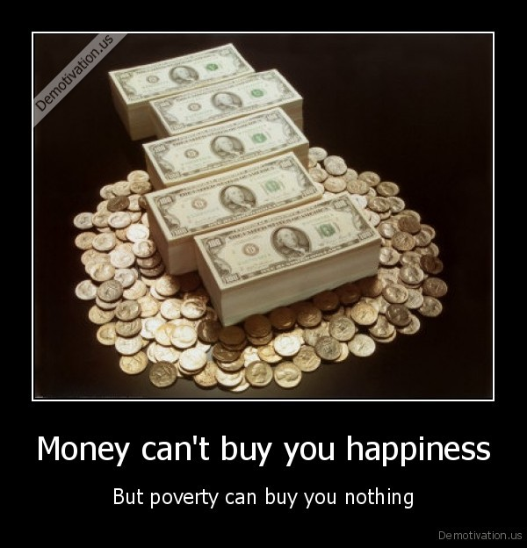
Title
Money Can’t Buy Happiness
But poverty can buy you nothing

Slide 9
Title
Whoever said money can’t buy happiness never bought a dog.

Slide 10
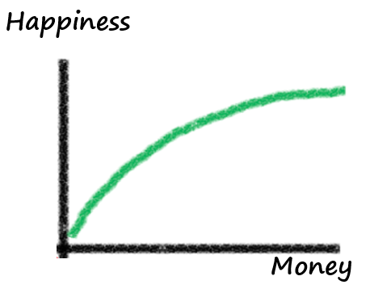
More Money = More Happiness?
Happiness
Money
Notes:
One article on “Money and Happiness” that I consulted gave some interesting data. The author writes, "The idea here is that while controlling for other factors that might influence happiness, a person's level of happiness should increase with the level of money that they possess. The same also applies to other items that are 'good' and also experiences. If you love chocolate, then two pieces of chocolate are better than one piece. If a holiday is enjoyable, two weeks on a holiday are better than only one week.
The happiness associated with money or the amount of a good thing does not increase in a straight line. The relationship is curved so that the more of something that you already have, the harder it is to increase your level of happiness by having more of it. So going from $10,000 to $20,000 yields a lot more happiness than going from $1,000,000 to $1,020,000. The second chocolate is not quite as enjoyable as the first one (unless you are a very serious chocoholic!). The second week on holiday doesn't bring quite as much relaxation benefits or fun as the first week. Economists call this diminishing marginal utility because the additional satisfaction (marginal utility) from having more of something diminishes with each additional unit. In other words, the additional happiness from one more dollar will be lower than it was for the previous dollar.
Now this all might make a lot of sense. The problem is that people simply don't assess happiness or satisfaction this way on a day-to-day basis. Sure, when people with more money are asked to take stock of their lives, they give the 'socially right' answer by saying that they are happier. However, when asked how happy they are at any particular point of time, people with more money are barely different to those with less money [Diener, Ng, Hartner and Arora (2010)].
So while this classical view of the relationship between money and happiness might make a lot of sense, it is completely wrong!"
Adapted from http://ahingston.wordpress.com/2012/12/14/money-and-happiness/

Slide 11
More Money = More Happiness?
John
Has $300,000
David
Has $500,000
Barry
Has $1,000,000
Notes:
I'd like you to conduct a quick thought experiment. Imagine three people: John, David and Barry. For the sake of the thought experiment, I'd like you to imagine that their lives are pretty much the same. They are all equally satisfied with their jobs, they are physically healthy and are all equally happy with their family and relationships. They drive the same type of cars and live in similar houses. Their lives are basically the same.
The only thing that is different is how much money they have. John has $300,000, David has $500,000 and Barry has $1,000,000.
Adapted from http://ahingston.wordpress.com/2012/12/14/money-and-happiness/

Slide 12
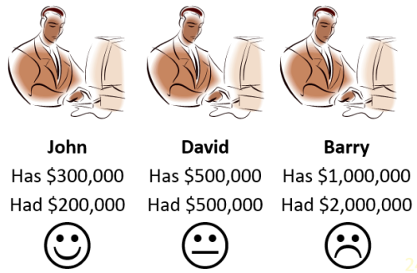
More Money = Less Happiness?
John
Has $300,000
Had $200,000
David
Has $500,000
Had $500,000
Barry
Has $1,000,000
Had $2,000,000
Notes:
"To illustrate why the classical view of the relationship between money and happiness is so wrong, let me add one more piece of information to our earlier thought experiment. One year ago, John had $200,000, David had $500,000 and Barry had $2,000,000. Do you see how this extra piece of information changes things quite a bit? John might only have $300,000 but he feels as though things are much better now. He has gained $100,000 in money over the last year. Indeed he has increased his money by 50% in one year and feels good about it. David has the same amount of money that he had one year ago. He is pretty neutral about his money since nothing has changed. He neither feels a sense of gain nor a sense of loss. Barry, on the other hand, is the least happy of the three. In fact, he is very annoyed. Last year he had $2,000,000 but he has lost half of it! He feels as though he has gone backwards."
Adapted from http://ahingston.wordpress.com/2012/12/14/money-and-happiness/

Slide 13
If money brought happiness, then the rich would have…
more genuine friendships
a lower divorce rate
more genuine smiles
more laughter
more leisure time to enjoy life
more purpose and direction in life

Slide 14
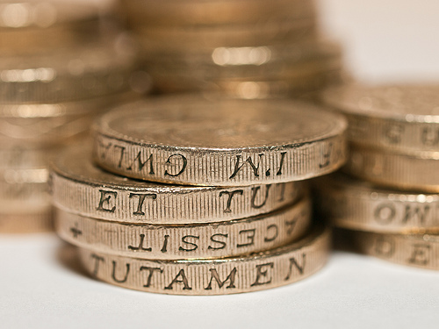
What should be our view of money?
Notes:
Is there any correlation between wealth and happiness?

Slide 15
MONEY MATTERS
Notes:
Our title today is Money Matters. It does! So let's look at the poor and the rich to see if there is any correlation between who is satisfied or dissatisfied with life.

Slide 16
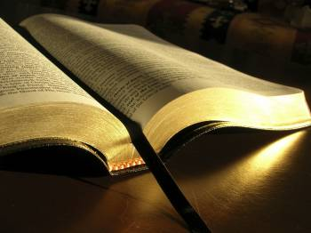
Solomon on Money in Ecclesiastes 5:8–6:9
Notes:
Solomon knew about wealth more than anyone, so what correlation did he discover between money and fulfillment in life?
He penned his conclusions in Ecclesiastes 5:8–6:9.
Solomon’s first conclusion regarding wealth here is a command…

Slide 17
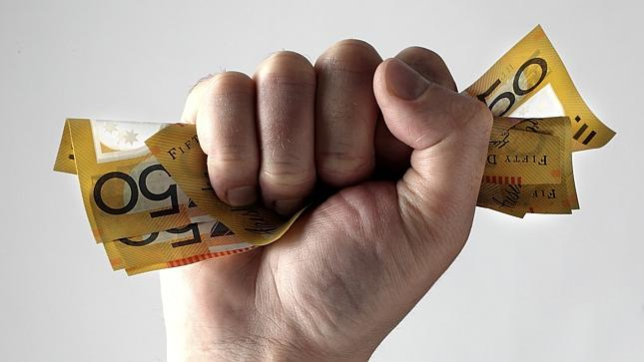
I. Don't be surprised that some corrupt officials hoard wealth (5:8-9).
Notes:
Some politicians’ motive is to pad their own pocketbooks.

Slide 18
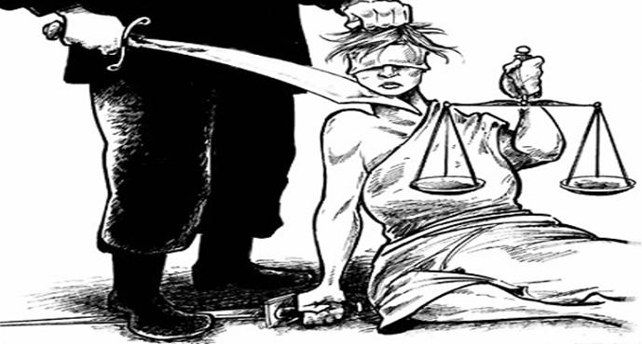
A. Oppression and denial of justice and righteousness shouldn't be surprising (5:8a).
B. Extortion and greed occur at all levels of government, including the top (5:8b-9).

Slide 19
Arabic letter "N" painted on the houses of Christians (marking them for destruction), which is the first letter of the word "Christian."
Notes:
ISIS continues its march across Iraq.

Slide 20
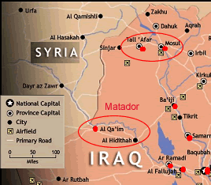
Map

Slide 21
I. Don't be surprised that some corrupt officials hoard wealth (5:8-9).
Notes:
Seeing the wealthy benefit from the hard work of the peons could discourage us, but…

Slide 22
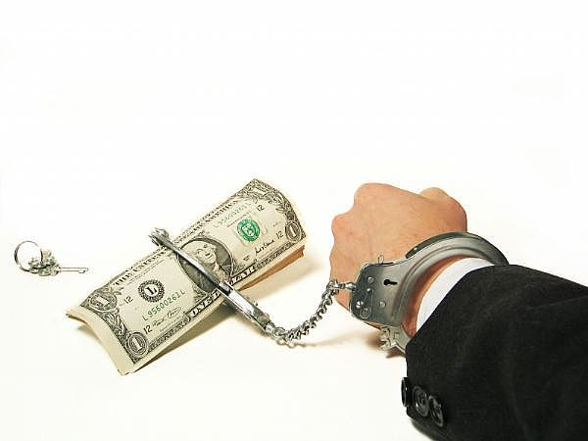
II. Materialism has many sad results (5:10-17)
Notes:
Money isn’t all that it’s cracked up to be!

Slide 23
Dissatisfaction: "Those who love money will never have enough. How meaningless to think that wealth brings true happiness!" (5:10 NLT).
Materialism's Sad Results

Slide 24
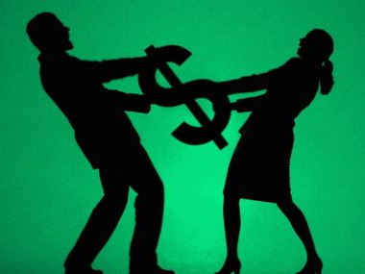
Marital Strife
Materialism's Sad Results

Slide 25
Be compatible regarding money!
Materialism's Sad Results

Slide 26
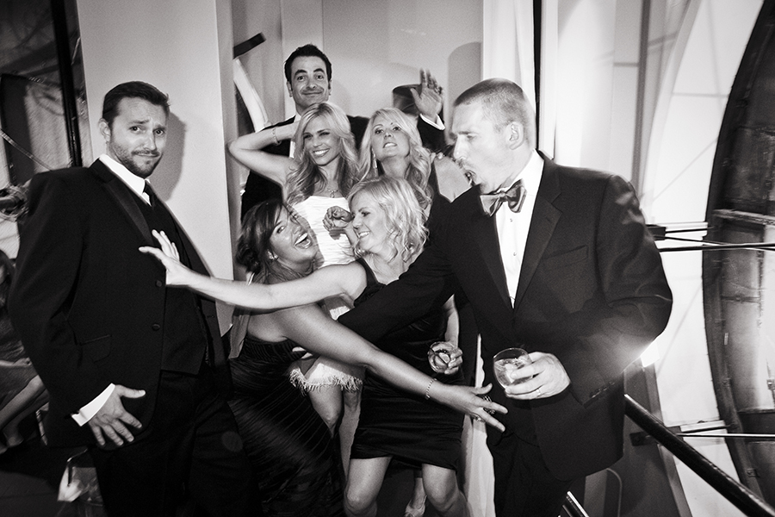
Higher Expenses: "The more you have, the more people come to help you spend it…" (5:11a NLT).
Materialism's Sad Results

Slide 27
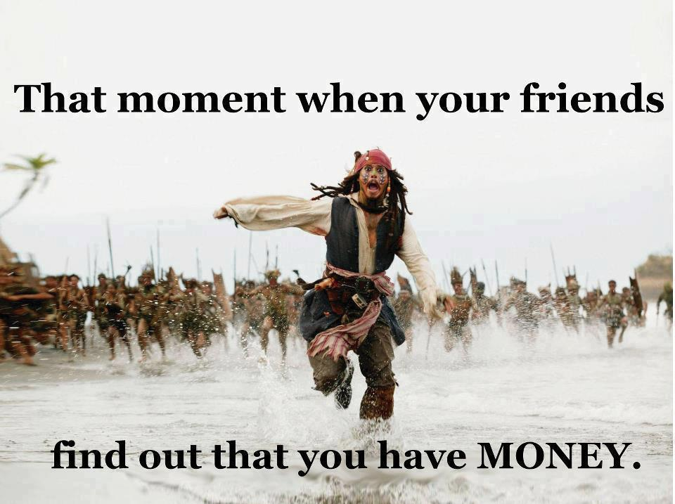
"The more you have, the more people come to help you spend it…" (5:11a NLT).
Materialism's Sad Results
That moment when your friends
find out that you have money.

Slide 28
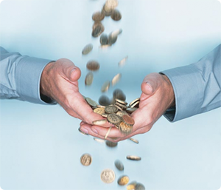
"…So what good is wealth—except perhaps to watch it slip through your fingers!" (5:11 NLT).
Materialism's Sad Results

Slide 29
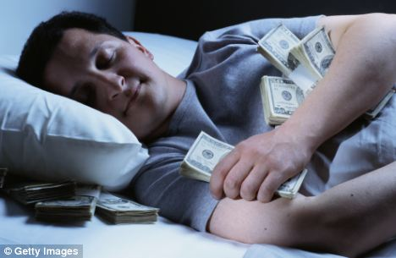
Really?
Materialism's Sad Results

Slide 30
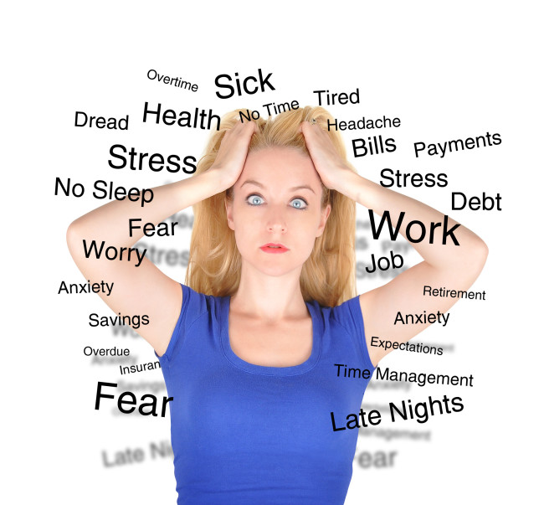
Sleeplessness: "People who work hard sleep well, whether they eat little or much. But the rich seldom get a good night's sleep" (5:12 NLT).
Materialism's Sad Results

Slide 31
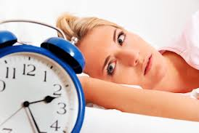
Do you lose sleep over money?
Materialism's Sad Results

Slide 32
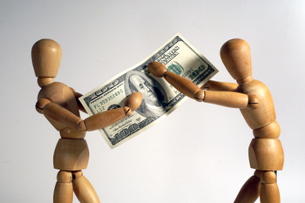
"There is another serious problem I have seen under the sun. Hoarding riches harms the saver" (5:13 NLT).
Materialism's Sad Results
Self-Inflicted Pains

Slide 33
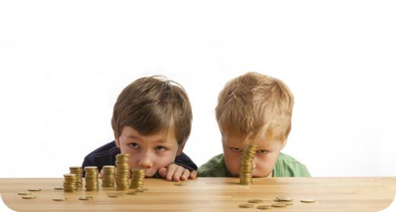
"Money is put into risky investments that turn sour, and everything is lost. In the end, there is nothing left to pass on to one's children" (5:14 NLT).
Materialism's Sad Results
No inheritance to leave for one's dependents

Slide 34
Nothing to take to the next life: "We all come to the end of our lives as naked and empty-handed as on the day we were born. We can't take our riches with us. ¹⁶And this, too, is a very serious problem. People leave this world no better off than when they came. All their hard work is for nothing—like working for the wind" (5:15-16 NLT).
Materialism's Sad Results

Slide 35
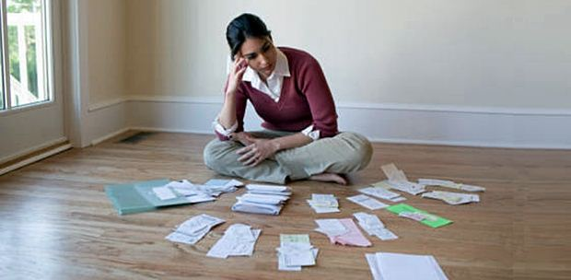
"Throughout their lives, they live under a cloud—frustrated, discouraged, and angry" (5:17 NLT).
Materialism's Sad Results

Slide 36
I. Don't be surprised that some corrupt officials hoard wealth (5:8-9).

Slide 37
II. Materialism has many sad results (5:10-17)
Notes:
In light of the many disappointments of seeking wealth, should we then live as hermits? No! God wants people to enjoy wealth because...

Slide 38
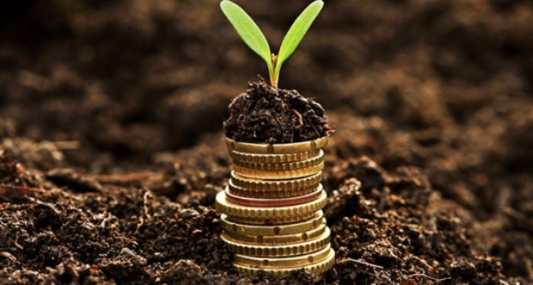
III. God gives money either for the worker or for others to enjoy (5:18–6:9).
Notes:
The Lord wants someone to benefit from money—either you or someone else!

Slide 39
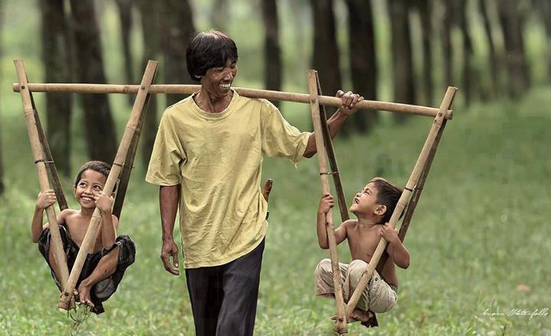
"Even so, I have noticed one thing, at least, that is good. It is good for people to eat, drink, and enjoy their work under the sun
during the short life God has given them, and to accept their lot in life" (5:18 NLT).

Slide 40
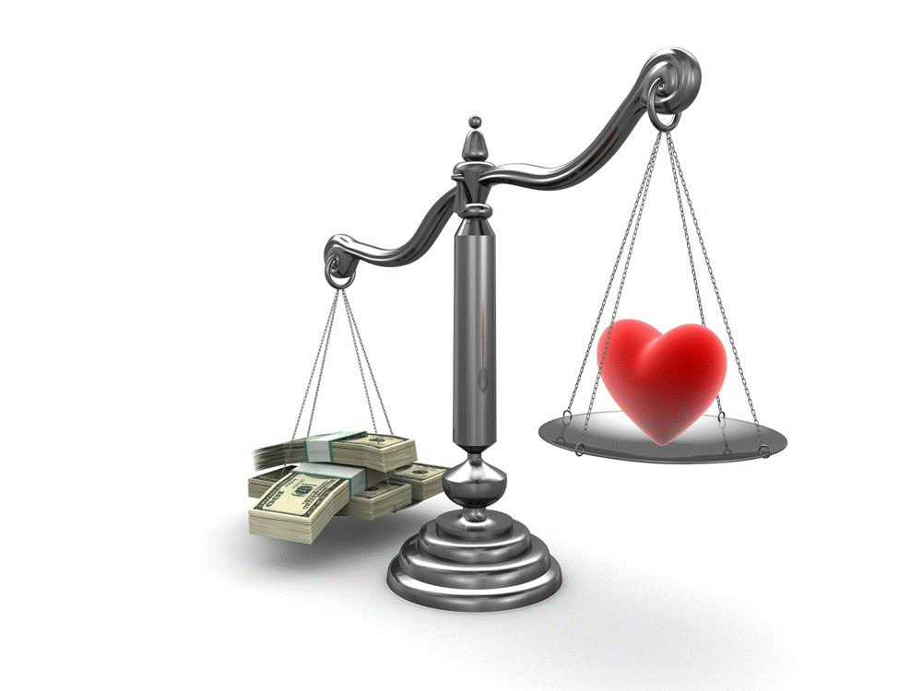
"Rich is the one who earns more than he spends and poor is the one whose expenses exceed his income."
Notes:
How do you know if you are rich or poor? Someone has said, “Rich is the one who earns more than he spends and poor is the one whose expenses exceed his income.”

Slide 41
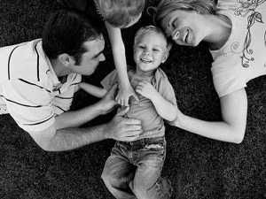
Enjoy what you have with who you have

Slide 42
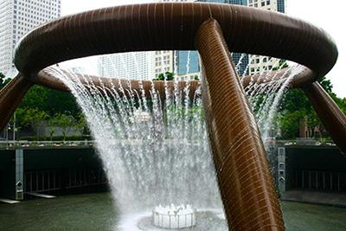
God allows some to enjoy their wealth as God's gift (5:19-20).

Slide 43
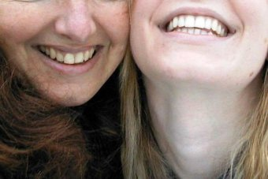
"And it is a good thing to receive wealth from God and the good health to enjoy it. To enjoy your work and accept your lot in life—this is indeed a gift from God" (5:19 NLT).
Notes:
Verse 19 shows us that God isn’t against money!

Slide 44
"God keeps such people so busy enjoying life that they take no time to brood over the past" (5:20 NLT).
Website
Notes:
Verse 20 says that accepting your lot in life helps you look forward instead of looking back at the past.

Slide 45
God prevents many from enjoying their riches and honor (6:1-2).

Slide 46
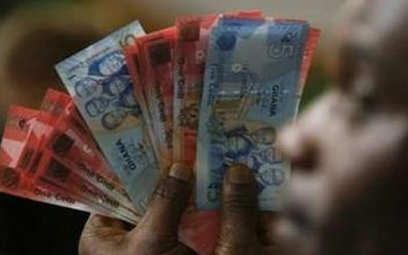
"There is another serious tragedy I have seen under the sun, and it weighs heavily on humanity. ²God gives some people great wealth and honor and everything they could ever want, but then he doesn't give them the chance to enjoy these things. They die, and someone else, even a stranger, ends up enjoying their wealth! This is meaningless—a sickening tragedy" (6:1-2 NLT).
Notes:
God prevents some people from enjoying their wealth and honor (6:1-2a).
God gives their wealth to others instead, which is very perplexing and painful (6:2b).

Slide 47
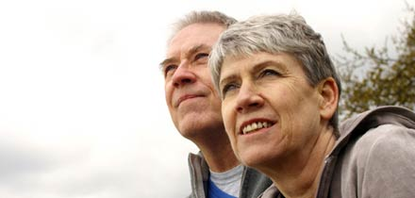
If you don't enjoy your possessions, then you will never enjoy life (6:3-9).

Slide 48
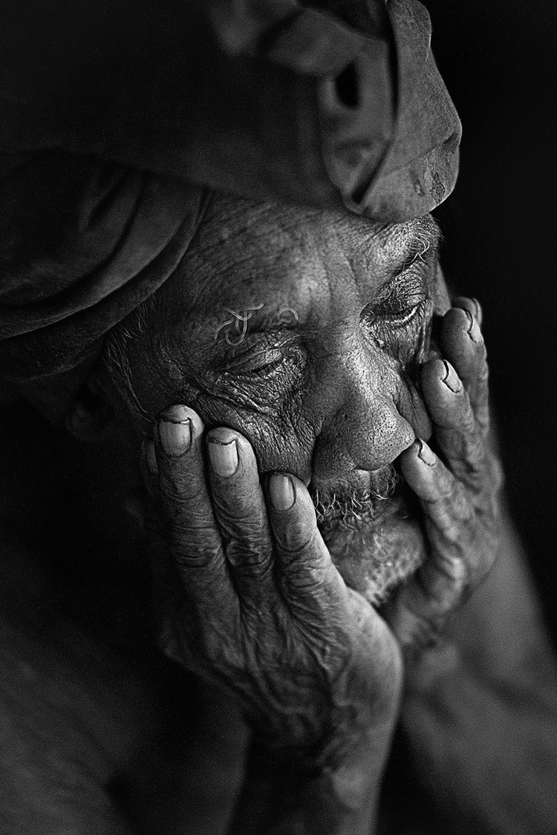
"A man might have a hundred children and live to be very old. But if he finds no satisfaction in life and doesn’t even get a decent burial, it would have been better for him to be born dead" (6:3 NLT).
Notes:
It is better to be stillborn than to be wealthy and miserable (6:3-6).

Slide 49
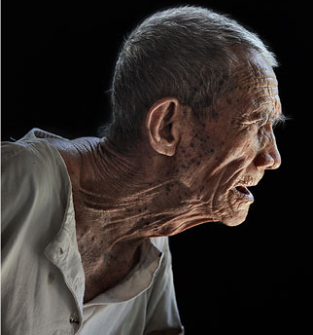
"His birth would have been meaningless, and he would have ended in darkness. He wouldn’t even have had a name, ⁵and he would never have seen the sun or known of its existence. Yet he would have had more peace than in growing up to be an unhappy man" (6:4-5 NLT).
Notes:
Miscarriages don't benefit from being born (6:4).
Miscarriages don't have any joys so they don't miss them (6:5).

Slide 50
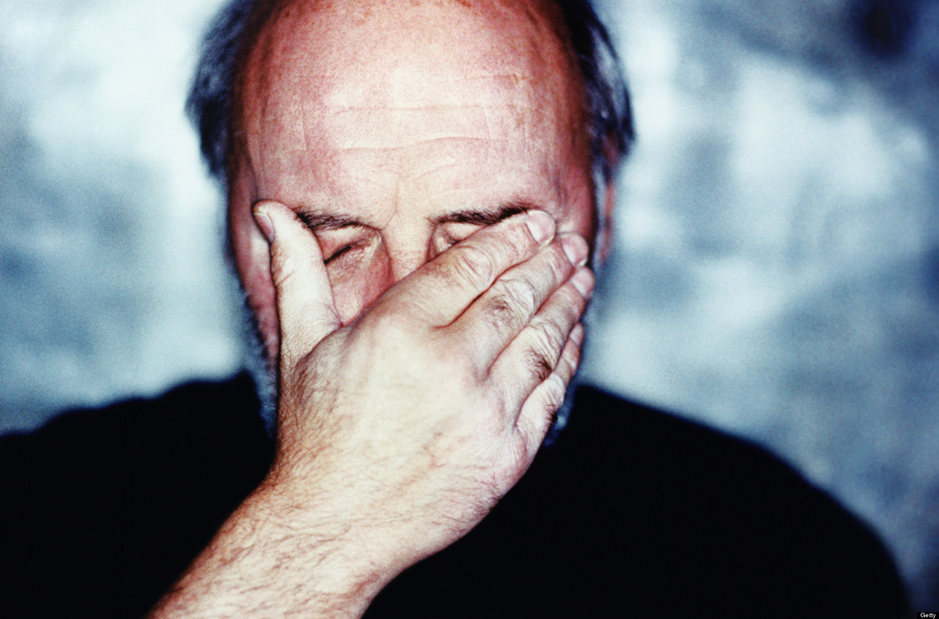
"He might live a thousand years twice over but still not find contentment. And since he must die like everyone else—well, what's the use?" (6:6 NLT).
Notes:
Miscarriages and rich, unfulfilled men both eventually die anyway (6:6).

Slide 51
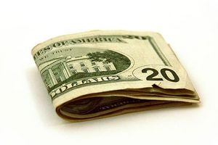
Life is futile for those never satisfied with their money (6:7-9).

Slide 52
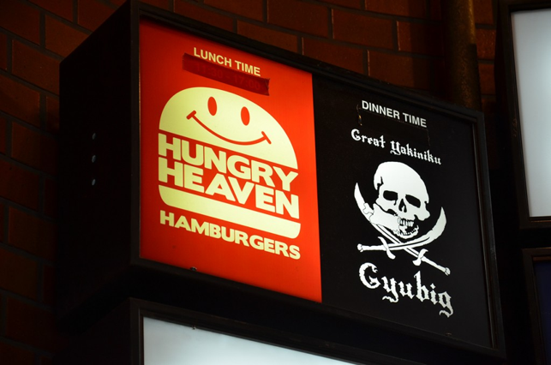
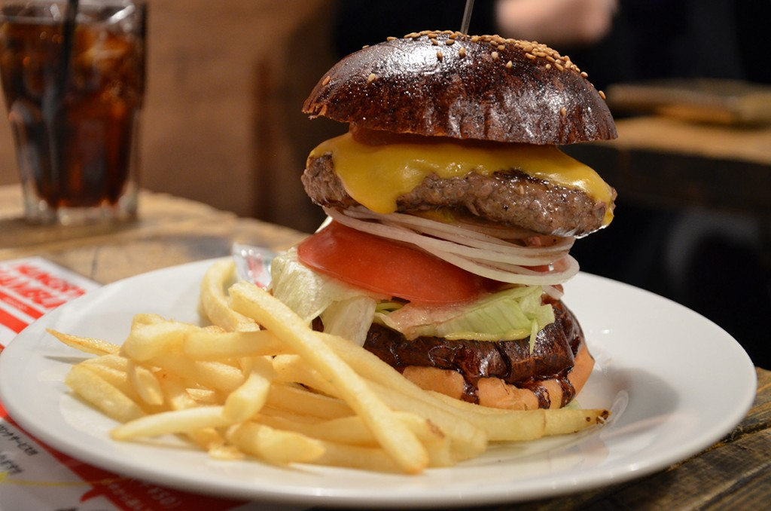
"All people spend their lives scratching for food, but they never seem to have enough" (6:7 NLT).
Notes:
We work to eat but food doesn't ultimately satisfy (6:7).
Some think that eating at places like Hungry Heaven in Tokyo will satisfy.

Slide 53
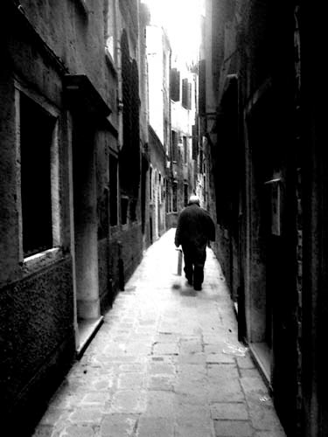
"So are wise people really better off than fools? Do poor people gain anything by being wise and knowing how to act in front of others?" (6:8 NLT).
Notes:
Wisdom and poverty don’t conquer materialism (6:8).

Slide 54
"Enjoy what you have rather than desiring what you don't have" (6:9a NLT).
Notes:
Materialists are never satisfied (6:9a).

Slide 55
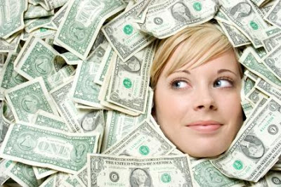
"Just dreaming about nice things is meaningless—like chasing the wind" (6:9b NLT).
Notes:
Materialism is a worthless pursuit (6:9b).

Slide 56
What should be our view of money?
Notes:
Wow, a lot of wisdom on money in one chapter! Can we sum it all up in a sentence? Try this…

Slide 57
Main Idea of 5:8–6:9
Materialism has many negative results but godly people can enjoy wealth.
Notes:
Hoarding money brings many disillusioning results, but one who honors God can enjoy money (restated MI).

Slide 58
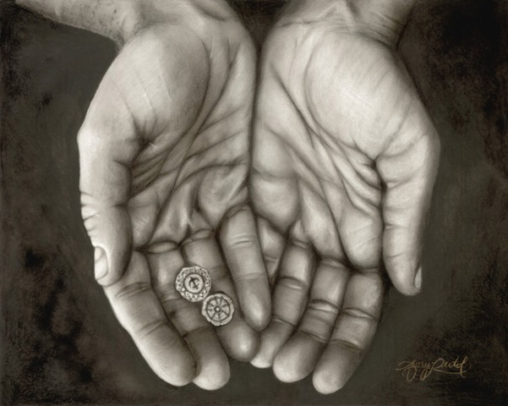
Three Profound Truths About Money…
Notes:
Solomon has given us three profound truths today:

Slide 59
I. Don't be surprised that some corrupt officials hoard wealth (5:8-9).

Slide 60
II. Materialism has many sad results (5:10-17)

Slide 61
III. God gives money either for the worker or for others to enjoy (5:18–6:9).
Notes:
The Lord wants someone to benefit from money—either you or someone else!

Slide 62
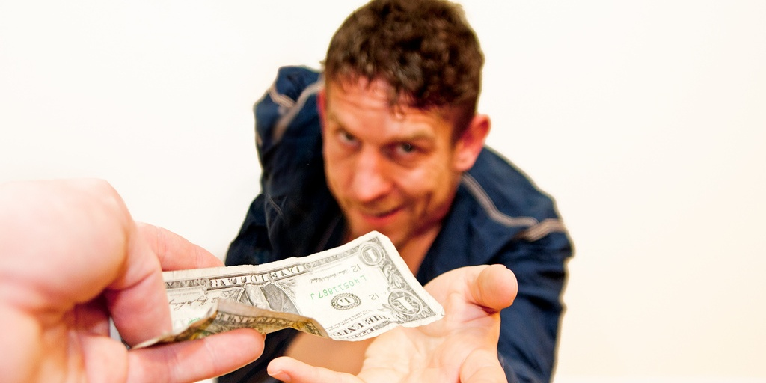
Are you satisfied with your amount of money?

Slide 63
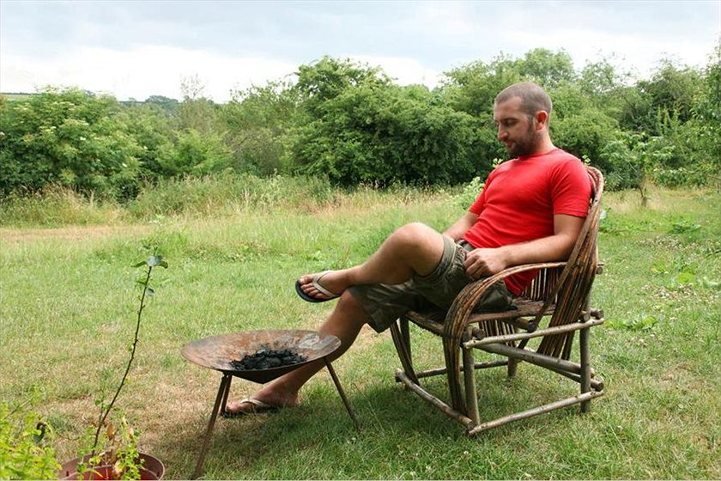
"Moneyless man finds happiness"
Notes:
Moneyless man finds happiness
Mark Boyle ABC Environment 9 Oct 2013
Mark Boyle believes that a life free of money liberates and inspires. Credit: Jose Lasheras (supplied)
See also
Related Story: The man who lives without money Mark Boyle 12 Apr 2010
Comments (174) Mark Boyle, a man who 5 years ago decided to live without money, is surviving and thriving. He has plans for a new venture and he just got engaged.
IT WAS 2008 and news of the deep-rooted problems in the financial industry had begun to hit the headlines. People were losing their jobs and their homes, and the institutions we perceived to be the bedrock of our society were crumbling around us. Within days we were on the verge of an "economic meltdown". Whilst my heart despaired for the ordinary people's lives that were being drastically affected by decisions made outside of their control, I remained insulated from it all through the unlikeliest of routes: I had just begun living completely without money.
Up to that point I had spent years feeling overwhelmed by the horrors I was witnessing around me — the mass extinction of species, homogenisation of cultures, mechanisation of our livelihoods and the general flat-packing of the Earth along the assembly line of industrial civilisation. I wanted to do something to act as a counter-friction to the cogs of the machine economy, which I believed were reducing our beautifully diverse world to cold, inanimate numbers. But as globalisation disempowers us through its sheer scale, I, like most of us, had absolutely no idea what meaningfully to do about any of it.
That all changed one day, after a long process of inquiry. I came to the understanding that, in general terms, these issues had a common denominator: they were symptoms of our perceived separation from the natural world and each other. This can seem like an abstract concept to grasp, but at its heart it means that, through various means, we have convinced ourselves that our own health is not dependent on the health of the Earth as a whole, and that somehow our fate is not linked to that of the intricate web of life we're inextricably dependent on. Through this realisation came a second one: that money is the most potent tool we possess in creating and perpetuating this illusion of separation and independence.
Through its function as a medium of exchange, money allows us to consume products with components or ingredients from all over the Earth. On a short-term and often superficial level, this can seem like it has many benefits. What wasn't being spoken about at the time, however, were the unintended consequences of money, and like all technologies, it has far-reaching and deep consequences. Apart from its widely ignored psychological, emotional, spiritual and physical effects on us personally, it also affords us an unwise buffer from the abuses and massacres that occur throughout the supply chains of the products we consume, and all the social and ecological problems associated with that.
After speaking out about these for a time, I began to feel that talk was cheap. I was also embroiled in the world of money as much as the next person, and so my arguments felt arrogant and theoretical. How could I know if a life without money was even possible or desirable, and if it was, how would it feel as a human to live without money in a world increasingly addicted to it? So in 2008 I decided to live without money, as a one year experiment initially. It became the greatest experience of my life.
A lot has changed since I started out on this path, both in myself and the world around me. As the financial world began to crumble, it became clear to me that this 'economic meltdown' was a misnomer; what it was, in fact, was a 'financial meltdown'. Politicians and economists alike have been conflating 'finance' with 'economics' for so long that we can now only imagine an economy facilitated by money.
The man who lives without money "If someone told me seven years ago, in my final year of a business and economics degree, that I'd now be living without money, I'd have probably choked on my microwaved ready meal..." Read the first part of Mark's story here. However, despite the headlines, another model — what anthropologists refer to as gift culture — was filling the void left by the dearth of money and credit. Economics, contrary to popular opinion, has very little to do with money; it is simply a social science concerned with how we meet our needs. Money is obviously one way of doing this. What I began learning in 2008 was that there are no end of ways you can meet your needs without money, and more than one way of being human in this world.
The gift economy has since become the only booming economy in the world. This ancient form has taken a very modern evolution, and much of it is now organised online. Many popular websites such as Couch-surfing, Freeconomy and Freecycle have seen an astronomical growth in membership as money has become scarcer, and more join every second. Many others projects, both local, national and global, are also helping people reduce their dependency on money. Thankfully this emerging movement is also moving away from its own dependence on industrial infrastructure, and ideas such as Freeshops, gift circles (regular meetings where people offer/request skills, tools, lifts, advice, stuff and so forth for free), clothes swapping parties and freeskilling evenings are quickly taking modern gift culture into a more personal, localised realm.
Life has changed for myself also. Three years after starting to live without money, I was lucky enough to meet someone who shared a similar outlook on life as myself, and within three months we were engaged. Next year we are planning a moneyless wedding. We want to show that you can have a celebration of love without burdening your first years of marital bliss with enormous debt ($37,500 is the average wedding spend), or racking up a hefty ecological footprint, in the process. The home-brew is already being made, and plans for the feast are being formulated. Instead of bringing presents and money for the bride and groom, friends and family will be invited to bring along something to be shared with everyone on the day: an instrument and a song, a bottle of raspberry wine, or their favourite dish. It will be based on participation instead of consumption.
We've also just begun setting up a three acre small-holding in Ireland. We've called it An Teach Saor, meaning The Free House in my mother tongue. Here we plan to merge fossil-fuel free permaculture principles with gift-based values. We're integrating everything from forest gardening to pedal-powered washing machines and humanure composting systems, no-dig perennial crops to rocket stoves and wormeries, into one holistic culture. Augment that with music, storytelling and art and you have the potential to create truly sustainable ways of living.
Our aim, apart from living free and happy lives, is to create closed loop systems that require no ongoing external inputs. It hasn't got all the glamour and glitz of urban life, but I feel it gives me a great sense of freedom, peace, meaning and connection to the entire community of life mine is dependent on. Those are experiences that I believe money can never buy.
Mark Boyle is the author of The Moneyless Man and The Moneyless Manifesto, released by his publishers under a Creative Commons licence. He is the founder of Freeconomy.
http://www.abc.net.au/environment/articles/2013/10/09/3864668.htm accessed 30 Aug 2014

Slide 64
What does the Bible say about money?

Slide 65
The one who gives is blessed!

Slide 66
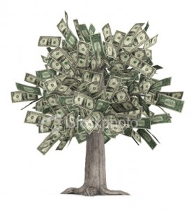
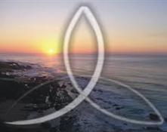
God?
or Money?
Notes:
Our happiness comes from whether we seek God or money. Which of these two do you seek more: knowing God or accumulating wealth?
Which pursuit takes more of your time? Or think about more?
Are you more interested in passing on to your children Jesus or money?

Slide 67
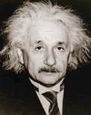
"Only a life lived for others is a life worthwhile" —Albert Einstein
Notes:
Einstein said to live for others…

Slide 68
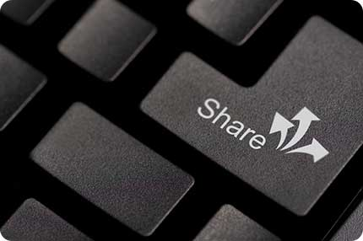
Share!
Notes:
—so do you share your money?

Slide 69
OT Preaching link at BibleStudyDownloads.org
Get this presentation and script for free!
Notes:
OT Preaching (op)

